Slide 1
Exergy analysis of geothermal Energy
Ali Akbar Eftekhari

Slide 2
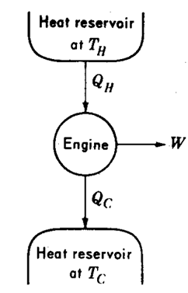
Carnot efficiency
(Maximum) Efficiency of an ideal heat engine is only a function of:
- Heat source temperature
- Heat sink (surrounding) temperature

Slide 3
Energy or Exergy
Heat Source @
900 K
Heat Source @
500 K
Q_{in}
Q_{in}
W_{net} = (1-300/900)Q_{in}
= 0.67 Q_{in}
W_{net} = (1-300/500)Q_{in}
= 0.4 Q_{in}
Power Cycle,
Carnot Engine
Power Cycle,
Carnot Engine
Work
Work
Q_{out,1}
Q_{out,2}
Heat Sink @ 300 K

Slide 4
Heat pump
Hot zone@
T_{h}
Q_{h}
Heat Pump,
Reverse Carnot cycle
COP =Coefficient Of Performance
W
Q_{c}
Cold zone@
T_{h}

Slide 5

Exergy (W)
Hot Water (80ºC),
100 m³/hr
Cold Water (20ºC)
Power (P)
3000 m
0.25 m
1000 m
1000 m
50 m

Slide 6
Some numbers
Production rate Φ_{V} =100 m³ / hr = 0.028 m³ / s
Reservoir = V = 1000 × 1000 × 100 m³
Diameter well = D = 0.3 m
Heat capacity at constant pressure = C_{p} = 4184 J/kg/K
Downhole temperature = T₂ = 80 + 273 K
Exit temperature = T₀ = 40 + 273 K
Project lifetime = 20 years
Darcy velocity = u = 4.2 × 10⁻² / 10⁵ = 4.2 × 10⁻⁷ m/s
Well velocity = v = 4.2 × 10⁻³ / πr² = 0.59 m /s
Reynolds = Re = ρvD/μ = 176838
Thermal conductivity sand : 2 W / m / K
Heat capacity sand : 2 × 10⁶ J / m³ / K

Slide 7
Pressure drop in the pipes
0.3 m
f = friction factor:
2000 m
For laminar flow
For f in other flow regimes, see Moody diagram
L = Length of pipe [m]
D = Diameter of pipe [m]
V = Liquid flow velocity [m/s]
ρ = Liquid density [kg/m³]
∆P = Pressure drop [Pa]

Slide 8
Pressure drop in porous media
∆P = Pressure drop [Pa]
μ = Fluid viscosity [Pa.s]
k = Permeability [m²]
u = Darcy velocity [m/s]
L = Length of porous media [m]
L = 1000 m
1000 m
Flow
Flow
100 m

Slide 9
Pumping exergy
Electrical Driver (η_{d})
Power Plant (η_{pp})
Fossil Fuel
Pump Mechanical Efficiency (η_{p})
Ex_{p} = Pump exergy consumption [J/s]
Q = Volumetric flow of water [m³/s]
∆P_{pipe} = pressure drop in pipes [Pa]
∆P_{PM} = pressure drop in porous media [Pa]

Slide 10
Steel and Cement embodied exergy
wells | 2
Depth | 2000 | m
Cement thickness | 30 | mm
Tube inside diameter | 300 | mm
Tube thickness | 10 | mm
0.3 m
2000 m
Steel | 58094.71 | kJ/kg
Cement | 2323.79 | kJ/kg
Steel density | 7850 | kg/m³
Cement density | 2000 | kg/m³

Slide 11
Drilling Exergy (Rotary drilling)
Drilling exergy consumption per meter | 68787.55 | kJ/m
Total exergy consumption | 1.38E+008 | kJ
Energy consumption | kJ | %
Drilling | 1.38E+008 | 1.48
Piping | 8.88E+009 | 95.33
Cementing | 2.98E+008 | 3.2

Slide 12
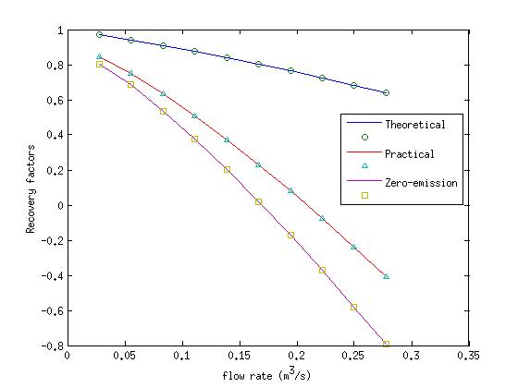
Recovery factors vs. flow rate

Slide 13
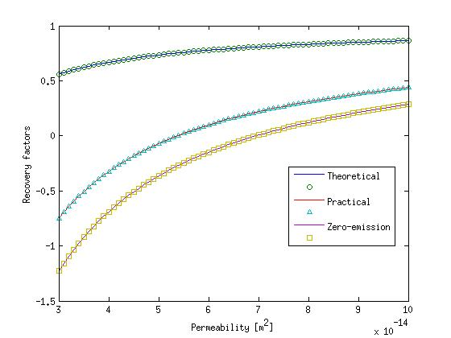
Effect of permeability

Slide 14
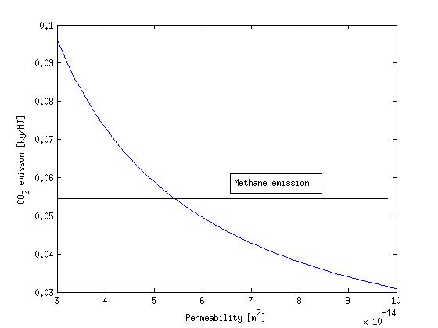
CO₂ emission per unit exergy

Slide 15
Exercise: Heating system of a room
T_{room}= 25 +273.15 K
Combustion of natural gas,
T_{h} = 1800 K (AFT)
1
Hot water of a geothermal well,
T_{h} = 80 + 273.15 K
Cold room,
T_{c} = 0.0ºC
2
Heat pump (main energy source is natural gas)
3
Q_{room}
Q_{c}
COP
Heat
Heat Pump
W
Power Plant
N.G.
Q_{c}
η

